Slide 1
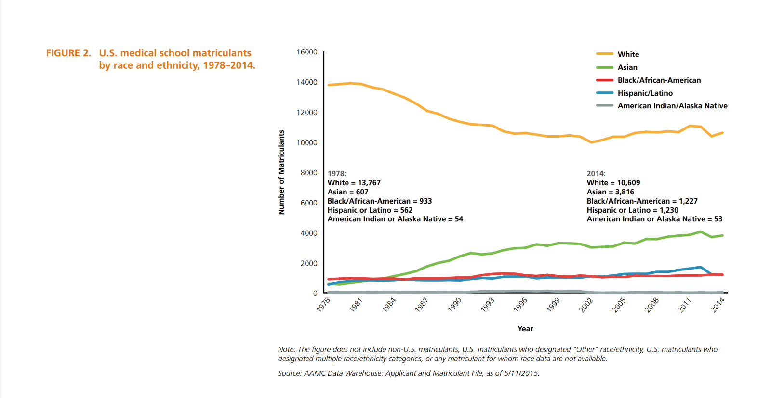
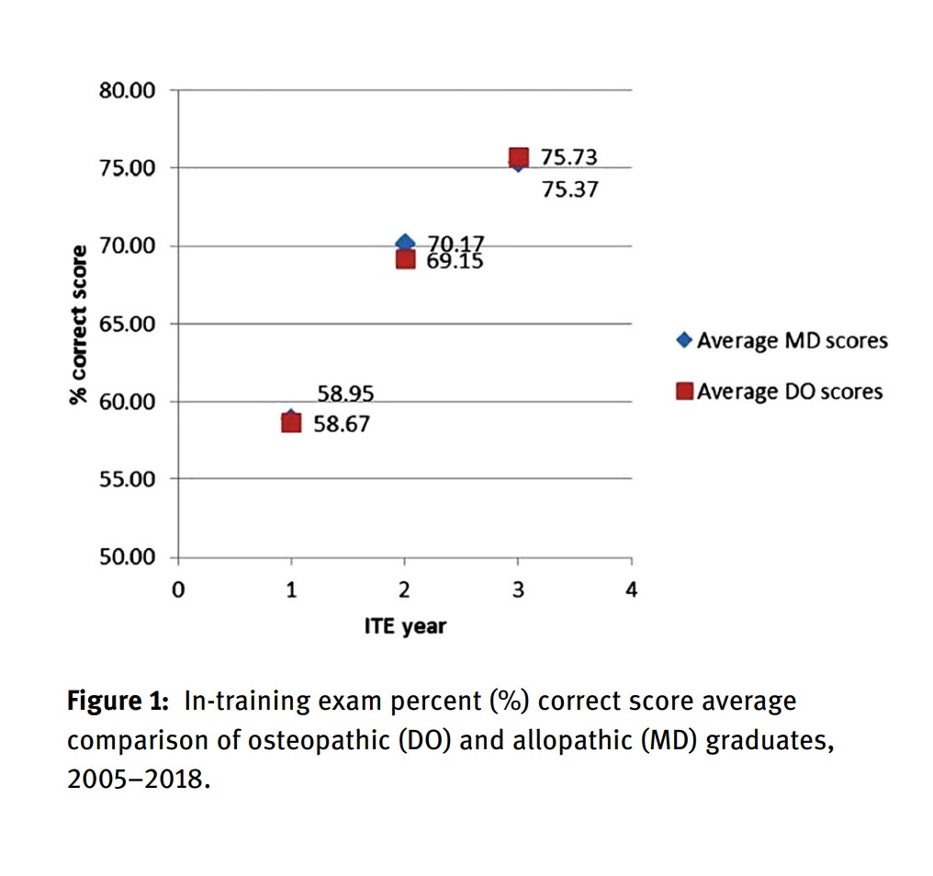
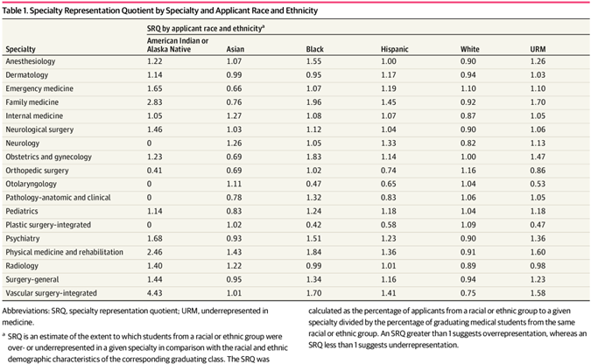
The Current State of Underrepresented Osteopathic Minorities in Competitive Specialties- A Literature Review​
Dashon Eure, Emmanuel Oyalabu, Steve Cochancela Guzman, Ezenna Obilor
Noorda College of Osteopathic Medicine
Results
Discussion
Background
According to the recent matriculation data, The National Resident Matching Program (NRMP) identifies several specialties as being particularly competitive
Including:
Interventional Radiology
Orthopedic Surgery
Plastic Surgery
Radiation Oncology
Vascular Surgery
Neurosurgery
Dermatology
Otolaryngology
To increase the number of URM and DO students in competitive specialties, programs should reevaluate their recommendations and perspectives on residency matriculation.
Both URM and Osteopathic students have low Representation in competitive specialties
Limitation-Only studies students observing URM or Osteopathic medical students separately applying to competitive specialties
More research observing URM osteopathic medical student match trends and barriers faced when applying to competitive
There has been a substantial amount of non URM’s matriculating into medical schools.- Courtesy of The University of Nebraska Medical Center
There was no statistical difference between the MD and DO dermatology residents’ scoring on the In-Training Exam at Case Western Reserve University Medical Center. Craig et al. 2020
Conclusion
Methods
Even though many osteopathic medical schools have traditionally emphasized primary care, several students continue to pursue competitive specialties. Recommendations to increase representation include but are not limited to:
Increasing URM Faculty at Medical Schools
Increasing exposure to Osteopathic Medicine
Providing Mentorship for URM Residents
A PubMed, Google Scholar, and Noorda-COM library resources literature review was conducted using the search terms: “ Match rates”,” URM” “Competitive specialties'', “Osteopathic students match rates”, “URM match rates”, “ URM osteopathic students”. Sixteen articles were generated during the search. The NRMP 2022 match data the AACOM reports were used.
Specialty Representation Quotient by Specialty and Applicant Race and Ethnicity Abbreviations: SRQ, specialty representation quotient; URM, underrepresented in medicine. Tiako et al . 2022

