Slide 1
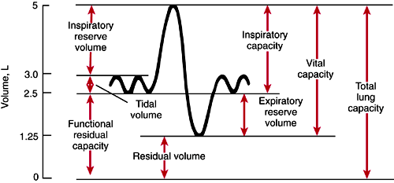
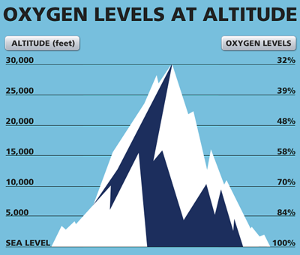
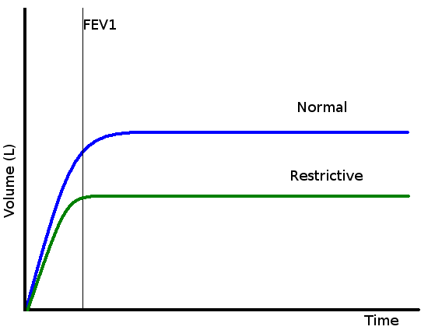
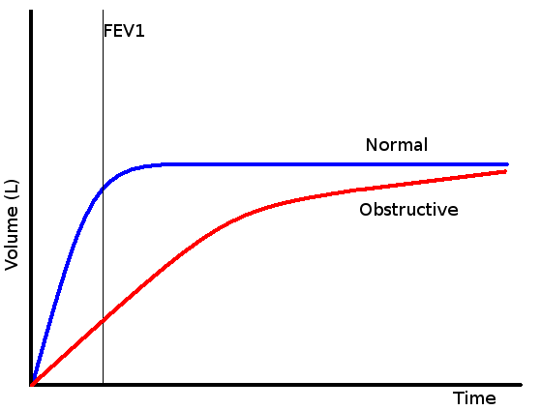
Change in Basic Pulmonary Function with Change in Altitude
Jaden Arnold*, Mindy Cook*, Bivash Neupane*, Erika Noonan MD, Rex Ripplinger MD
¹Department of Biomedical Sciences, Noorda College of Osteopathic Medicine, Provo, UT
*Authors Contributed Equally
Background
Methods
Results (Expected)
Altitude sickness is a well-known phenomenon among those who frequently participate in mountain-based outdoor activities. It is caused by the sudden decrease in available atmospheric oxygen and is usually experienced within 6-24 hours after reaching an elevation of 2500m (8200 ft) above sea level (NHS).
This study aims to determine the effects of moving from a location of low elevation to a location of high elevation on lung function, as measured by spirometry. The methods described below are widely used in respiratory physiology research and provide a reliable and valid method of evaluating changes in lung function.
It is expected that when an individual initially arrives at a location of higher elevation, lung function will be decreased due to the lower availability of oxygen.
We expect a period of adjustment, where it will take time for lung function to return to normal levels following a move to higher altitude.
During the adjustment period, we expect to see some participants with symptoms similar to those seen in altitude sickness.
Figure 1. Depicts the various lung volumes and capacities that can be assessed. Image obtained from EmergencyPedia.
Conclusion
Our proposed study will track changes in pulmonary function over time after moving from a region of low elevation (1,000 feet above sea level or lower) to one of high elevation (4,500 feet above sea level in Provo, Utah).
Subjects will be recruited from incoming students at Noorda College of Osteopathic Medicine that hail from places of elevation lower than 1,000 feet.
Participants will undergo spirometry testing to index their tidal volume, respiratory rate, forced vital capacity, forced expiratory volume, and peak expiratory flow rate.
Initial testing on subjects will be completed within seven days of arriving in Provo, UT.
Repeat testing will occur monthly over the subsequent 6-10 months.
Changes in the above markers will be graphed over time.
Data will be analyzed using descriptive statistics and repeated measures analysis of variance (ANOVA) to compare the differences in lung function before and after the change in elevation.
The ANOVA model will take into account the individual differences in baseline lung function and the changes in lung function over time.
The objective of this study is to increase the knowledge base on the affect elevation has on lung function and how quickly our lungs can adjust to a change in elevation. We hope this data will be useful in preparing individuals relocating to higher elevations for the changes they can expect in their pulmonary function as they adjust to the elevation increase. This awareness will allow individuals to take steps to improve their performance, reduce their risk of altitude-related illnesses, and make informed decisions about their health and safety. Moreover, understanding the effects of altitude on lung capacity can also inform research into pulmonary and cardiovascular diseases, helping to develop new treatments and interventions.
Image 1. Oxygen availability at various altitudes. Image obtained from Public Health Notes.
Symptoms of altitude sickness typically include:
Headache
Nausea
Fatigue
Dizziness
Loss of appetite
Shortness of breath
Activities that include a dramatic shift in elevation often involve preparation to prevent altitude sickness. While this is a common practice among mountaineers, preparing for the elevation change when moving from San Diego, California to Provo, Utah is one that is not often discussed.
Conclusions
References
Figure 2. Depicts the Forced Expiratory Volume per 1 second (FEV1) in an individual with restrictive lung conditions. Image obtained from EmergencyPedia.
Figure 2. Depicts the Forced Expiratory Volume per 1 second (FEV1) in an individual with obstructive lung conditions. Image obtained from EmergencyPedia.
NHS. (2020, March 13). Altitude sickness. NHS. Retrieved February 8, 2023, from https://www.nhs.uk/conditions/altitude-sickness/
Figure 3. HbA1c scores

