Slide 1
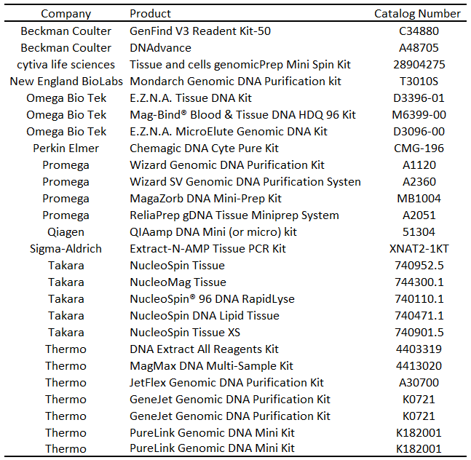
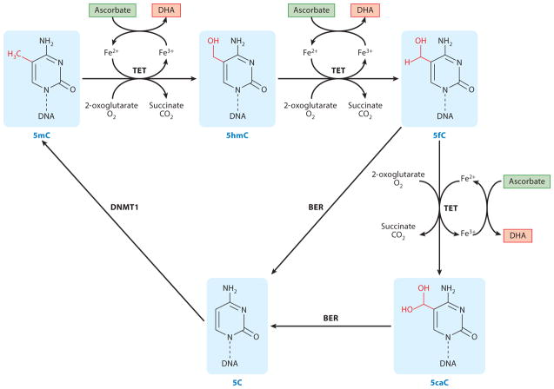
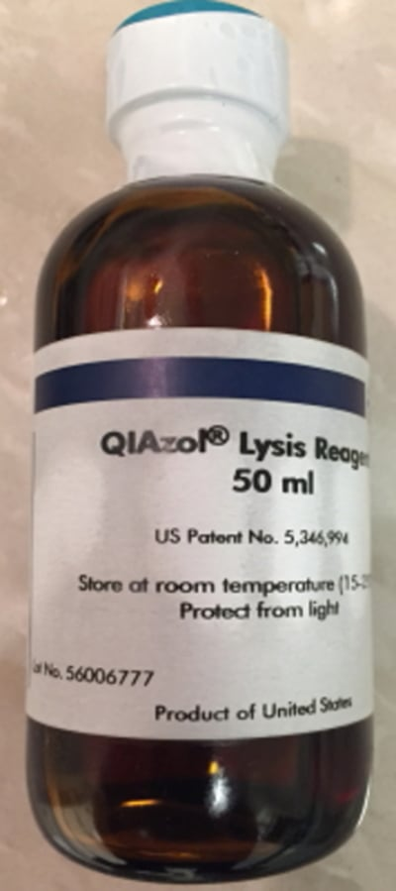
Testing Extraction of DNA from Lipid-Rich Tissues Using Various Reagents and Commercially Available Kits
Ryan Powers*, Walker Kay*, Jonathon Reynolds, Nathaniel Hill, Cole Farnsworth, Molly Henley, Alfred Amendolara, Noah Boekweg, John A. Kriak, Kyle B. Bills, David W. Sant
Department of Biomedical Sciences, Noorda College of Osteopathic Medicine, Provo, UT *Authors Contributed Equally
Background
Results
Results Cont.
Studying epigenetic modifications such as DNA methylation requires DNA to be obtained from specific tissues.
DNA extraction from lipid-rich tissue may cause column clogging and retention of lipids in the final product, which may inhibit PCR.
Phenol-chloroform extractions can be used to separate lipid layers from DNA, which can subsequently be extracted using commercially available kits.
In order to determine the most effective commercially available extraction kits, three different phenol-chloroform products will be tested in combination with 30 different commercially available DNA extraction kits
Figure 1. Graph of quantity of tissue collected in grams, separated by gender.
Figure 2. adapted from Young et al. 2015 Annu Rev Nutr. Various cytosine modifications change with tissues and in disease states, necessitating extraction of DNA directly from tissues.
Table 1. Kits obtained for extraction of DNA from lipid-rich tissues
Picture 1. Example of Sprague Dawley rats used in this study
Conclusion and Future Directions
Methods
Sample Size: 48 rats, collected postmortem from other studies
Collected tissues:
Brain
Visceral adipose tissue
Epicardial adipose tissue
Pancreas
Sciatic nerves
Reagents: Qiazol, Trizol, and Tri Reagent
Number of extraction kits: 26 (additionally kits likely to be added)
A sufficient amount of lipid-rich tissue has been obtained from the 48 rats used in this study.
We are presently awaiting the arrival of the kits listed in Table 1 and are ready to proceed with the DNA extraction in combination with the reagents shown in Picture 2.
Once the test kits have arrived, we will proceed with testing the extracted DNA for epigenetic markers and assessing kit efficacy.
A
B
C
Picture 2. Picture of tested reagents. (A) TRIzol (B) QIAzol (C) TRI reagent.

