Slide 1

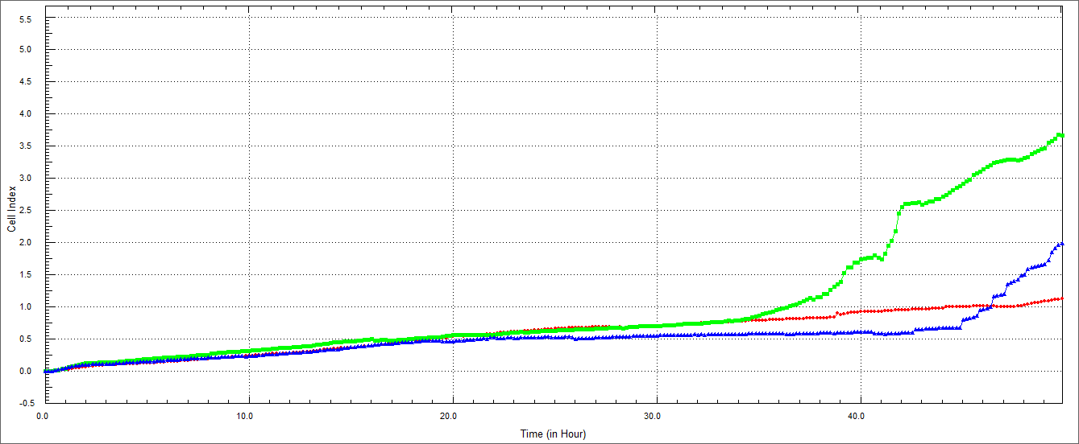

RAGE inhibition reduces TIMP and decreases cell invasion in cigarette Smoke extract (CSE) treated oral squamous carcinoma cells
Gregg Davis¹, Edward Yeates¹, Duane Winden¹, Benjamin Bikman², Paul R. Reynolds^{1,2} Juan Arroyo^{1,2}
¹ College of Dental Medicine, Roseman University of Health Sciences, South Jordan, UT, 84095
² Department of Physiology and Developmental Biology, Brigham Young University, Provo, UT, 84602
Abstract
Results
Results (Continued)
Objectives: Oral squamous cell carcinoma (OSCC) is a common disease affecting approximately thirty thousand people in the United States each year. One of the major causes of such cancer is exposure to tobacco smoke. Recently our laboratory observed a Receptors for Advanced Glycation End-products (RAGE) dependent regulation of OSCC cells invasion in culture. Furthermore, we observed increased expression of Matrix metalloproteinases (MMPs) by smoke environment In these cells. The mechanistic effects of secondhand smoke in the development of gingival carcinoma are limited and warrant more investigation. Our objective was to determine cell invasion regulators during Cigarette Smoke Extract (CSE) in gingival squamous cell carcinoma invasion.
Methods: Ca9-22 cells were cultured in RPMI supplemented with 10% of fetal calf serum. Cells were cultured in the presence or absence of CSE and semi-synthetic glycosaminoglycan ethers (SAGEs), a known inhibitor of RAGE signaling. Real time cell invasions were performed, and cultured cells were lysed for western blot analysis.
Results: Treatment of cells with CSE showed: 1) increased invasion (2-fold; p<0.05) reduced by SAGES, 2) Increased metalloproteinases (MMP)-2,9 and 14 expression (1.4-fold, 3.0-fold, 3.4-fold; p<0.05) downregulated by SAGEs and 3) Increased TIMP (1.5-fold; p<0.03) downregulated by SAGEs.
Conclusions: We conclude that CSE is able to increase invasion of gingival squamous cell carcinoma cells. Also, we conclude that SAGEs are sufficient to reduce increased cell invasion in gingival cancer cells induced by CSE. And that the reduction of the increased invasion correlates with the reduction on MMP and TIMP production. These results may prove useful in providing avenues that could explain invasive molecules regulated by secondhand smoke in the development of gingival squamous cell carcinoma.
Figure 1. RAGE expression in Ca9-22 cells. 0.05% CSE treatment significantly increased RAGE expression in treated cells. This increase was reduced when cells were treated with CSE + SAGEs.
Figure 5. MMP 14 during CSE and SAGEs. Metalloproteases 14 were increased in cells treated with CSE. MMP 14 was reduced when cells were treated with CSE + SAGEs.
*p<0.03
Figure 5. TIMP during CSE and SAGEs. TIMP was increased in cells treated with CSE. Expression was reduced when cells were treated with CSE + SAGEs.
Figure 2. Ca9-22 invasion with CSE and SAGEs. CSE increased invasion of Ca922 cells which was reduced when cells were treated with CSE + SAGES.
Conclusions
Procedures
Our research reveals that CSE increase RAGE production that is reversed with the Addition of Sages.
Invasiveness of Ca9-22 oral squamous cell carcinoma cells in RAGE dependent manner
That MMP 2, 9 and 14 could be mediators of this invasion in a RAGE dependent manner
That TIMP could be involved in the regulation of MMPs during invasion od OSCC cells.
These results may prove useful in providing avenues that could explain the role of secondhand smoke in the invasion of gingival squamous cell carcinoma.
Cell culture
Ca9-22 Oral squamous cell carcinoma cells were used for these experiments. Ca9-22 cells were cultured in RPMI medium (Mediatech, Manassas, VA) supplemented with 10% fetal bovine serum (FBS) and 1% penicillin and streptomycin.
Cell treatments
Ca9-22 cells were treated with 0.05% Cigarette Smoke Extract (CSE) for 24 hours in the presence or absence of SAGEs.
Real time cell invasion
Ca9-22 cells were plated at a concentration of 20,000 cells/well in the presence or absence of CSE and SAGES. The cells were place in the RTCA DP instrument and invasion readings were done every 15 minutes for 24 hr.
Western Blot
Control and treated cells were lysed in protein lysis buffer. Membranes were incubated overnight with an antibody against MMP 3,9, and 14 and TIMP.
Statistical Analysis
Data shown as Mean±SE. P<0.05 was considered significant.
Figure 3. MMP 2 during CSE and SAGEs. Metalloproteases 2 was increased in cells treated with CSE and reduced when cells were treated with CSE + SAGEs.
Figure 4. MMP 9 during CSE and SAGEs. Metalloproteases 9 was increased in cells treated with CSE. Expression was reduced when cells were treated with CSE + SAGEs.

