Slide 1
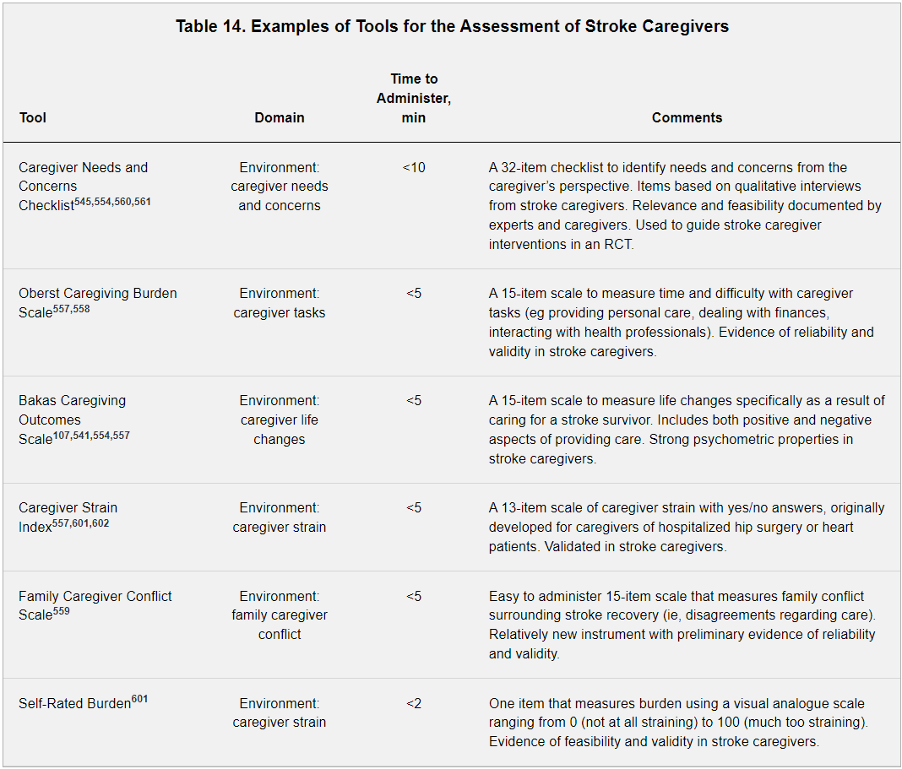
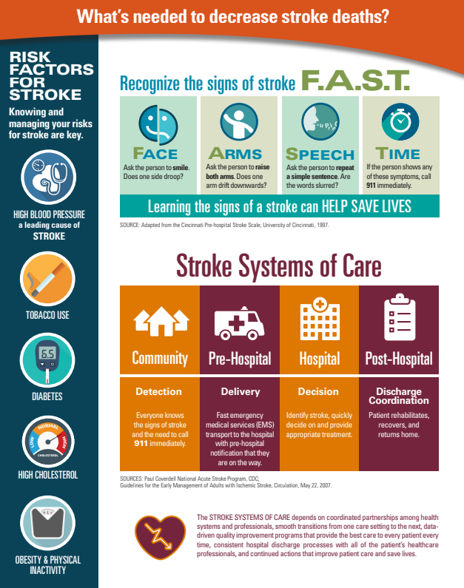
Examining Current Resources Available for Stroke Caregivers
^{Andrew Barlow}
1) Noorda College of Osteopathic Medicine 2) Dr. Alice Akunyili
Background
During the web search, no educational materials were found that targeted stroke caregivers.
Results
There are more than 140,000 deaths due to strokes in the U.S. each year “Stroke Facts”. In 2017 to 2018, the direct and indirect cost of strokes in the U.S. was $52.8 billion with Home Health Care accounting for 7.4 billion of the total cost (Tsao, 2022). In Utah, stroke was the sixth leading cause of death in 2020, with 916 deaths due to strokes “Health Indicator Report of Stroke Deaths”.
Worldwide, 25% to 74% of stroke survivors require some assistance or are fully dependent on caregivers for activities of daily living (Miller, 2010). The unexpected onset of a stroke can often leave caregivers with a myriad of unmet needs. A majority of these needs center around lack of education, training, and support in taking care of a stroke patient (Cobley, 2013). In a qualitative study caregivers reported the most frequent unmet needs were delays in home rehabilitation and lack of communication from hospital clinicians (Ski & O’Connell, 2007). The purpose of this study is to explore current discharge instructions given in the state of Utah and caregiver satisfaction with the discharge instructions.
During the web search, no educational materials were found that targeted stroke caregivers. The educational material available targeted recognizing a stroke and targeting major risk factors of strokes. This was a preliminary finding of online materials that will be added to with physical visits to healthcare systems to compare electronic educational materials with physical educational materials.
Methods
A web search was used to find the electronic stroke discharge instructions given to caregivers at Intermountain Healthcare, MountainStar Healthcare, Steward, and University of Utah Healthcare. In the future, I plan to meet in person with medical personnel from these Healthcare systems to find what physical discharge instructions are given to caregivers. Additionally, I plan to use survey research methods with a variety of questionnaires and interviews with caregivers to assess the level of satisfaction with discharge instructions.
Source: Comprehensive Overview of Nursing and Interdisciplinary Rehabilitation Care of the Stroke Patient
A Scientific Statement From the American Heart Association. Sep 2, 2010.
Conclusion
The preliminary finding of no educational materials available for stroke caregivers raises more questions as to what materials are available for stroke caregivers. Future studies will examine physical educational materials, surveys to gauge satisfaction with educational materials, and interviews to assess what can be added to ensure caregivers have the resources they need.
References
Centers for Diseases Control and Prevention. (n.d.) Stroke Facts. https://www.cdc.gov/stroke/facts.htm
Cobley, S. Christine (2013) A qualitative study exploring patients’ and carers’ experiences of Early Supported Discharge services after stroke. https://journals.sagepub.com/doi/10.1177/0269215512474030
Miller, L. Elaine (2010) Comprehensive Overview of Nursing and Interdisciplinary Rehabilitation Care of the Stroke Patient. https://www.ahajournals.org/doi/10.1161/STR.0b013e3181e7512b?url_ver=Z39.88-2003&rfr_id=ori:rid:crossref.org&rfr_dat=cr_pub%20%200pubmed
Public Health Indicator Based Information System (IBIS) Utah’s Public Health Data Resource. (n.d.) Health Indicator Report of Stroke (Cerebrovascular Disease) Deaths. https://ibis.health.utah.gov/ibisph-view/indicator/view/StrDth.html
Ski, Chantel (2007) Stroke: the increasing complexity of carer needs. https://pubmed.ncbi.nlm.nih.gov/17591413/
Tsao, W. Connie et al., (2022) Heart Disease and Stroke Statistics–2022 Update: A Report From the American Heart Association. https://www.ahajournals.org/doi/10.1161/STR.0b013e3181e7512b?url_ver=Z39.88-2003&rfr_id=ori:rid:crossref.org&rfr_dat=cr_pub%20%200pubmed

