Slide 1
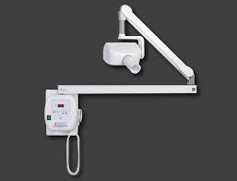
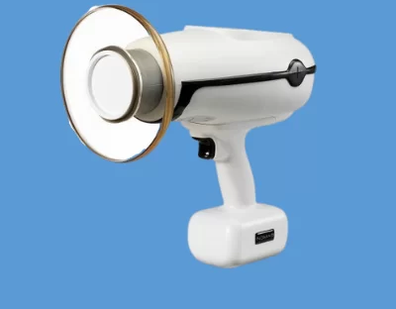
Comparison of Radiographic Exposure During RCT Using Wall Mounted Units vs Nomad Mobile Units: A Retrospective Study
M. Smith, M. Hogue, B. Ricks, Dr. A Mohajeri, and Dr. J.F. Wisniewski- P.I.
Background Information
Figures:
Methods
When taking radiographs, only one study has been conducted comparing wall-mounted units vs hand-held units regarding number of radiographs taken as well as the quality of these radiographs
Phillips, Billy James. A Comparison of Intraoral Image Quality, Error Rates, Operator and Patient Dosimetry Between a Hand-held Device and Wall-mounted X-ray Sources. University of North Carolina at Chapel Hill, 2014. https://doi.org/10.17615/zymn-8c13
Figure A:
Criteria to be analyzed for each Endodontic case:
number of exposures during procedure
cone cutting
foreshortening
elongation
contact overlap
poor contrast
image blurring
underexposure
apex (portion of tooth anatomy required) attainment in the radiograph
Research Questions
Will the Number of radiographs obtained in patients receiving root canal treatment in a dental school using a hand-held unit be greater than the number of radiographs obtained when utilizing a wall mounted unit?
Radiograph Grading:
Grade 1 → Excellent, no errors
Grade 2 → Acceptable, some errors
Grade 3 → Unacceptable, diagnostically useless
Khan A, Javed MQ, Iqbal R, Khan F, Habib SR. Quality Assurance Audit Of Intra-Oral Periapical Radiographs At The Undergraduate Dental School. J Ayub Med Coll Abbottabad. 2020 Jul-Sep;32(3):327-330. PMID: 32829545.
When Patients receive root canal treatment in a dental school, will the number of radiographic errors occuring be more when a hand-held unit is used as compared to when a wall-mounted unit is utilized?
Wall Mounted Unit
Objectives
Figure B:
RESULTS
To compare the number of radiographs taken when Endodontic procedures were completed utilizing wall-mounted unit vs a hand-held unit.
Results are pending.
Retrospective Review of Charts has not yet started
IRB was just approved on December 8, 2022
To assess the quality of radiographs taken when endodontic procedures were completed utilizing a wall-mounted unit versus a hand-held unit
Implications
Data from this research project will help better understand the implications of using wall-mounted units vs hand-held units regarding:
The quantity of radiographic exposures
the number and types of errors
taken during these endodontic procedures.
Methods
Retrospective study of endodontic cases completed by undergraduate dental students at Roseman CODM
Charts Analyzed with CDT – Endodontic procedure codes 3310 and 3320
Number of Cases to be analyzed
50-100 cases w/ wall-mounted unit used
50-100 cases w/ hand-held used
Acknowledgement
The Authors wish to thank Roseman College of Dental Medicine-Clinical Outcomes Research Education (CORE) for their support of this research project.
NOMAD Radiographic Unit

