Slide 1
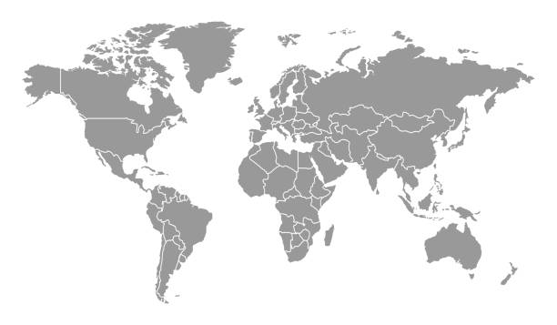
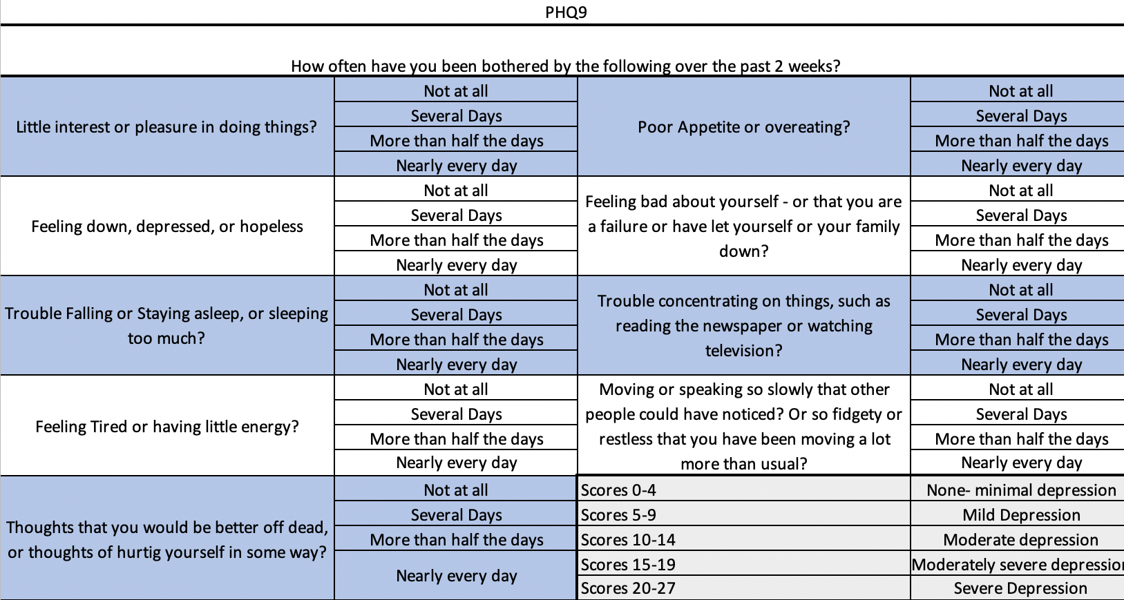
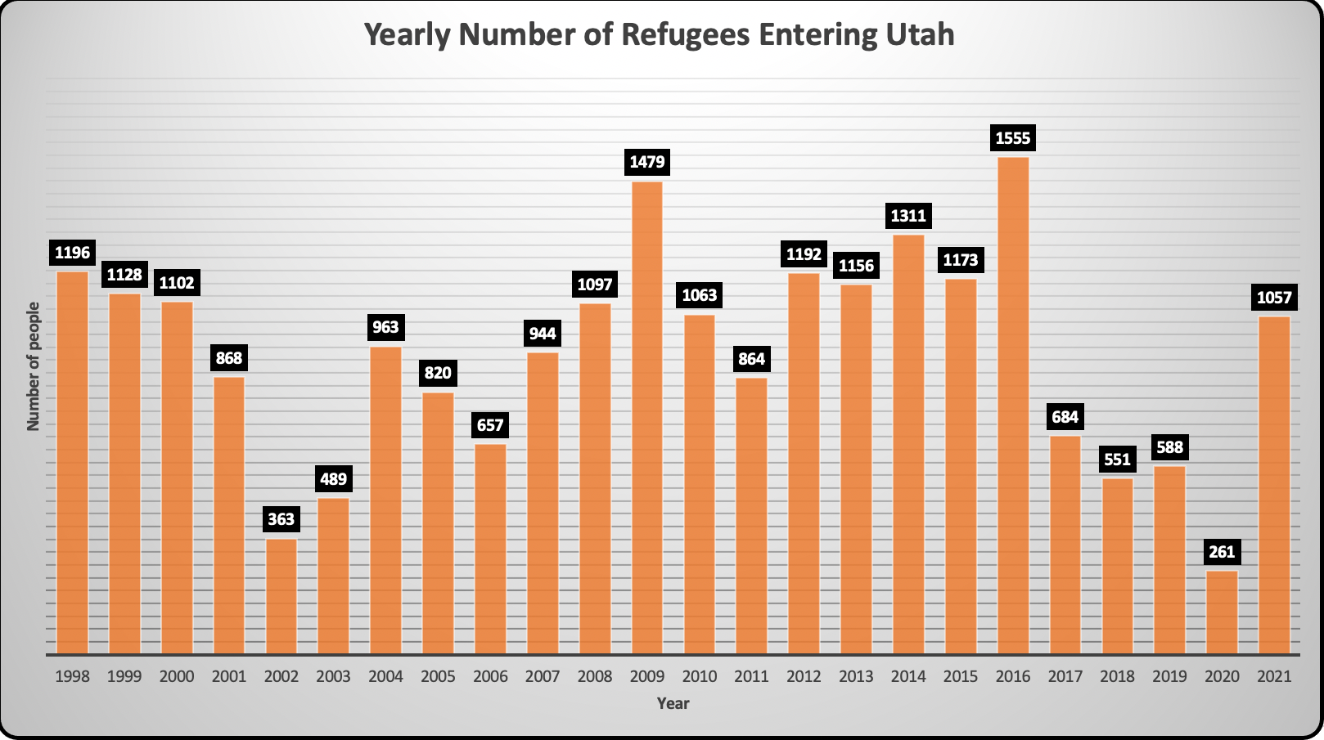
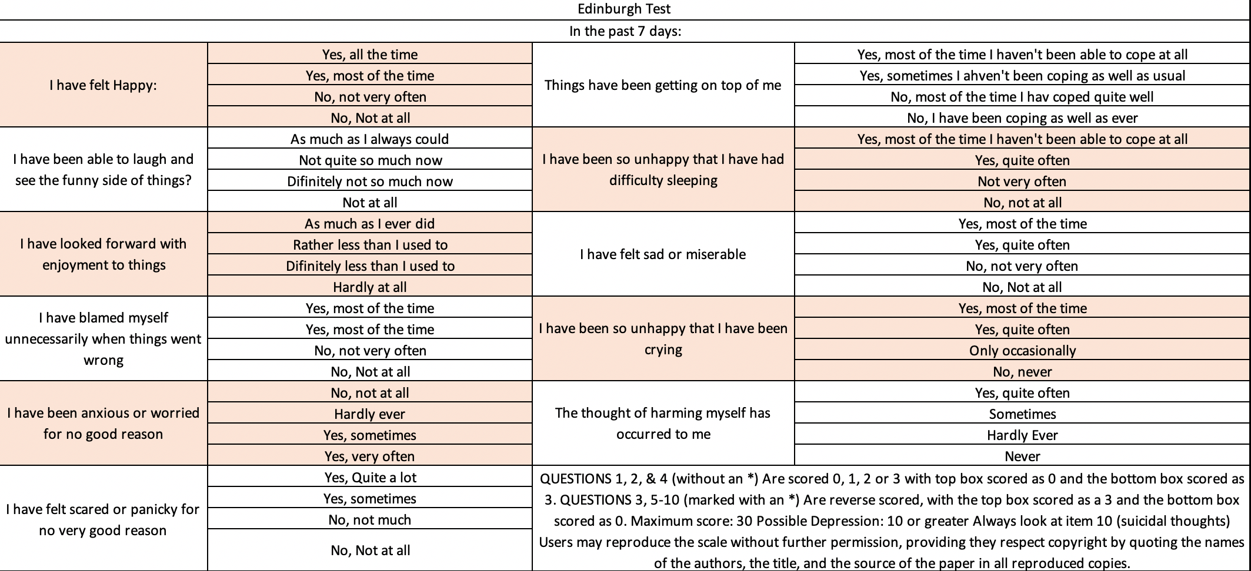
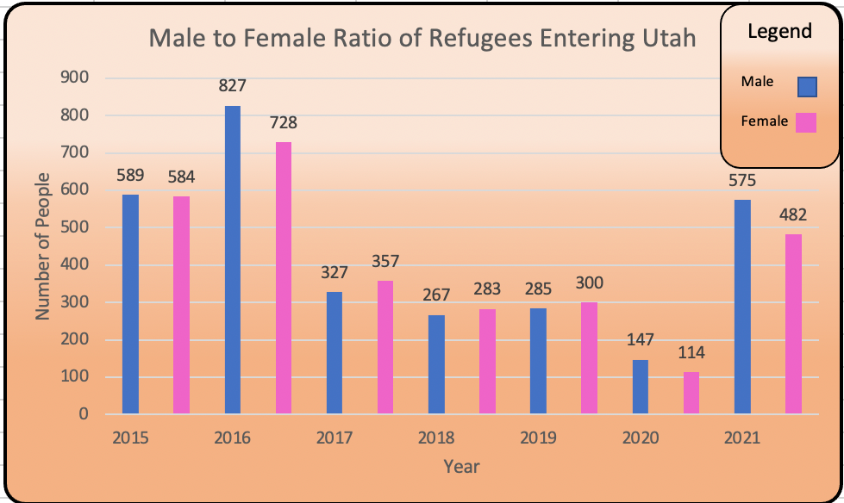
Post-Partum Depression (PPD) Screening Tools Effectiveness in Refugee Populations # 83
Joshua Jensen, Margaret Freking and Alice Akunyili, MD
¹Department of Biomedical Sciences, Noorda College of Osteopathic Medicine, Provo, UT
Purpose:
Immigrant mothers check all the boxes that are significant risk factors for developing or exacerbating Postpartum Depression (PPD). These risk factors include, suffering in solitude, cultural conceptualizations, barriers to help seeking, and a lack of facilitators to help seeking. Despite this very little research has been done to find effective screening methods for this population.
The purpose of this research project is to compile the works of those before me to determine whether the Edinburgh Postnatal Depression or the PHQ 9 screening tool is the most effective for immigrant mothers. Further research projects will be conducted using the most efficient screening method to see the prevalence of PPD in the Utah refugee population.
Methods:
Research determining the effectivity of the two tests has been published. By comparing the two tests together and measuring the data sets I will be able to determine which of the two screening tests are more effective at determining the results of PPD in an immigrant population.
Results:
The PHQ test was found to have the widest reach across cultural barriers, while the Edinburgh screening test was facilitated by interpreters present during the screening causing the patient some reluctance in opening to the physician. Effectiveness was shown in multiple studies to come more from the screening method of the physician than the screening tool itself.
Origin Countries of a Majority of Refugees in USA
Ukraine
Syria
Afghanistan
Venezuela
Sudan
Eritrea
Central African Rep.
Myanmar
Somalia
D.R. of the Congo
South Sudan
Conclusions:
Both the PHQ 9 and the Edinburgh screening tools were found to be effective, though the method in which they were used was seen to be the key indicator of a successful screening. Due to the PHQ-9 9 test having many culturally appropriate translations, it was seen as the more effective test to determine depression. Overall during the physician screening process most physicians felt that the tools would be ineffective because they were facilitating the tools often through several barriers, cultural and lingual being the foremost.
more effective at determining the results of PPD in an immigrant population.
References:
Health Indicator Report of Refugee arrivals. (2022). Ibis.health.utah.gov/ibisph-view/RefArr.html
Mahboubeh Dadfar, Z. K., 2 David Lester2. (2018). Reliability and Validiy of the Farsi Version of the Patient Health Questionnaire-9 (PHQ-9) with Iranian Psychiatric Outpatients. Trends in Psychiatry and Psychology. https://www.scielo.br/j/trends/i/2018.v40n2/
Cox, J. L., Holden, J.M., and Sagovsky, R. (1987). Edinburgh Postnatal Depressoin Scale. https://www.fresno.ucsf.edu/pediatrics/downloads/edinburghscale.pdf

