Slide 1
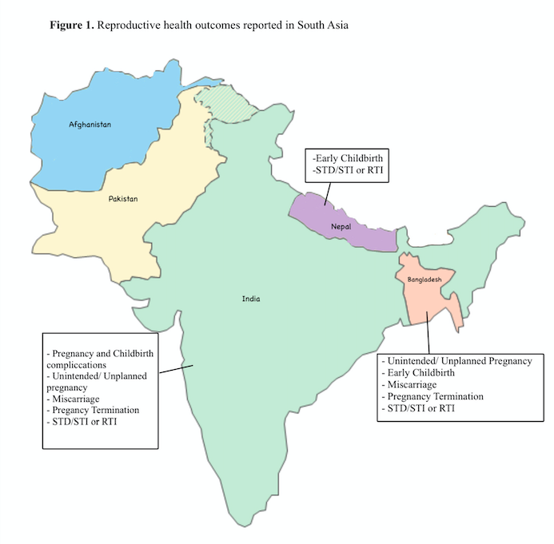
Early Marriage and Reproductive Health Outcomes Among Women in South Asia
Sameen Kazmi, MPH
1) Noorda College of Osteopathic Medicine 2) Thomas Jefferson University
Background and Objective
Results
Discussion
Child marriage (marriage before 18) is a human rights violation and against the law in many countries yet still prevalent in many parts of the world.
South Asia has the highest prevalence of child marriage.
30% of women get married before 18
8% of women get married before 15
Child marriage has detrimental affects on both the physical and mental health of women.
Undernutrition
Increased risk of cervical cancer
Increased risk of HIV/AIDS
Depression and Anxiety
Dire social consequences for the girls such as an increased risk of intimate partner violence (IPV) and lower education rates.
Impact on women’s reproductive health is less researched compared to mental health research and social impacts.
Objective: Evaluate published literature and identify the most common reproductive health problems associated with child marriage; use the knowledge to advocate for interventions especially targeted towards preventing child marriage and ways to improve the reproductive health of already affected girls
Study Characteristics:
Types of study designs across studies: cross-sectional, secondary analysis, random sample survey, population-based study, community-based study.
Methods used to collect data across studies: structured questionnaire in an interview format, data extraction from national health surveys, gynecological and clinical examinations, data from a previously conducted randomized control trial.
Average sample size of N=16,966.82 with a range of 166 to 90,303
Preventing child marriage:
Policies and programs to empower young girls with information, skills and support networks; educate parents and community members to shift their attitudes and behaviors; increase girls’ access to education; providing incentives, opportunities, and financial support to the girls and their families.
Addressing adolescent sexual and reproductive health:
Educating young girls and boys about puberty, sex and safe-sex practices, pregnancy, fertility, contraceptive methods, etc.
Increasing girls’ access to modern contraceptive methods, safe abortion services, as well as safe delivery and post-delivery care.
Initiate partner-oriented programs to encourage shared decision making and responsibilities towards ensuring the healthy status of a woman’s reproductive health.
Methods
Strengths
Inclusion Criteria: full-text; peer-reviewed; original research studies; written in English; conducted in either India, Pakistan, Bangladesh, Nepal, or Afghanistan; participants are girls who had gotten married before the age of 18; reproductive health outcomes present in results.
Reproductive health outcomes covered: pregnancy and childbirth complications, unintended/ unplanned pregnancy, early childbirth, miscarriage, pregnancy termination, eclampsia, and sexually transmitted diseases/ infections or reproductive tract infections
Exclusion Criteria: articles only reporting fertility outcomes; sample includes unmarried women, men, couples, and mother-child duos; study assesses participants’ attitudes, perceptions, and knowledge levels; study looks at utilization of reproductive health items and services, contraceptive behaviors, contraception use, consumption of medications and pills; outcome described newborn health and mortality of the mother or child; studies which addressed associations of intimate partner violence, domestic violence, physical or sexual violence with reproductive health outcomes; articles which did not include age range and marital status of participants in the abstract
Reproducible
Objective data
Up-to-date
Studies have large sample sizes
Limitations
Data collection and analysis conducted by a single reviewer
Only two databases included in the search strategy
Self reported data can lead to recall bias and selective reporting bias
Main Findings:
Compared to women who got married as adults, women who got married as children experienced a high prevalence of pregnancy and delivery complications, unwanted pregnancies, pregnancy termination, miscarriage, preterm delivery, giving birth at an early age, and symptoms of reproductive tract infections and sexually transmitted infections.
Child marriage and early childbirth identified as factors which induce obstetric fistula, a type of childbirth injury due to prolonged and obstructed labor.
Early marriage increased the likelihood of experiencing abnormal genital discharge, testing positive for human immunodeficiency virus, and demonstrating a high prevalence of T.vaginalis infection.
Contact
Email: do26.srkazmi@noordacom.org
References furnished upon request

