Slide 1

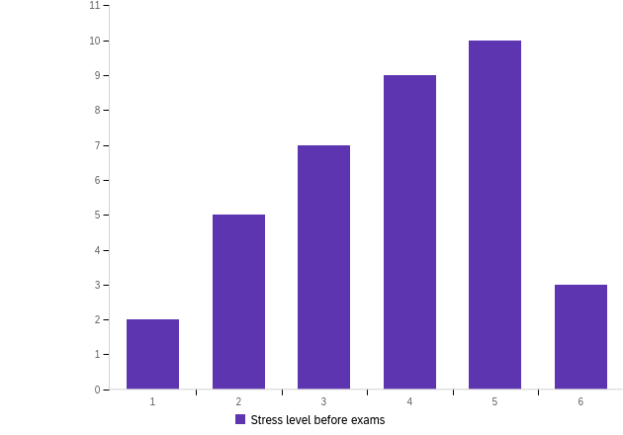
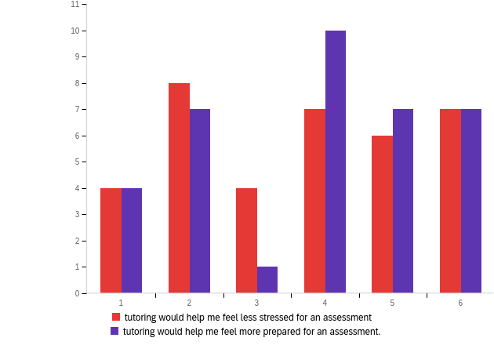
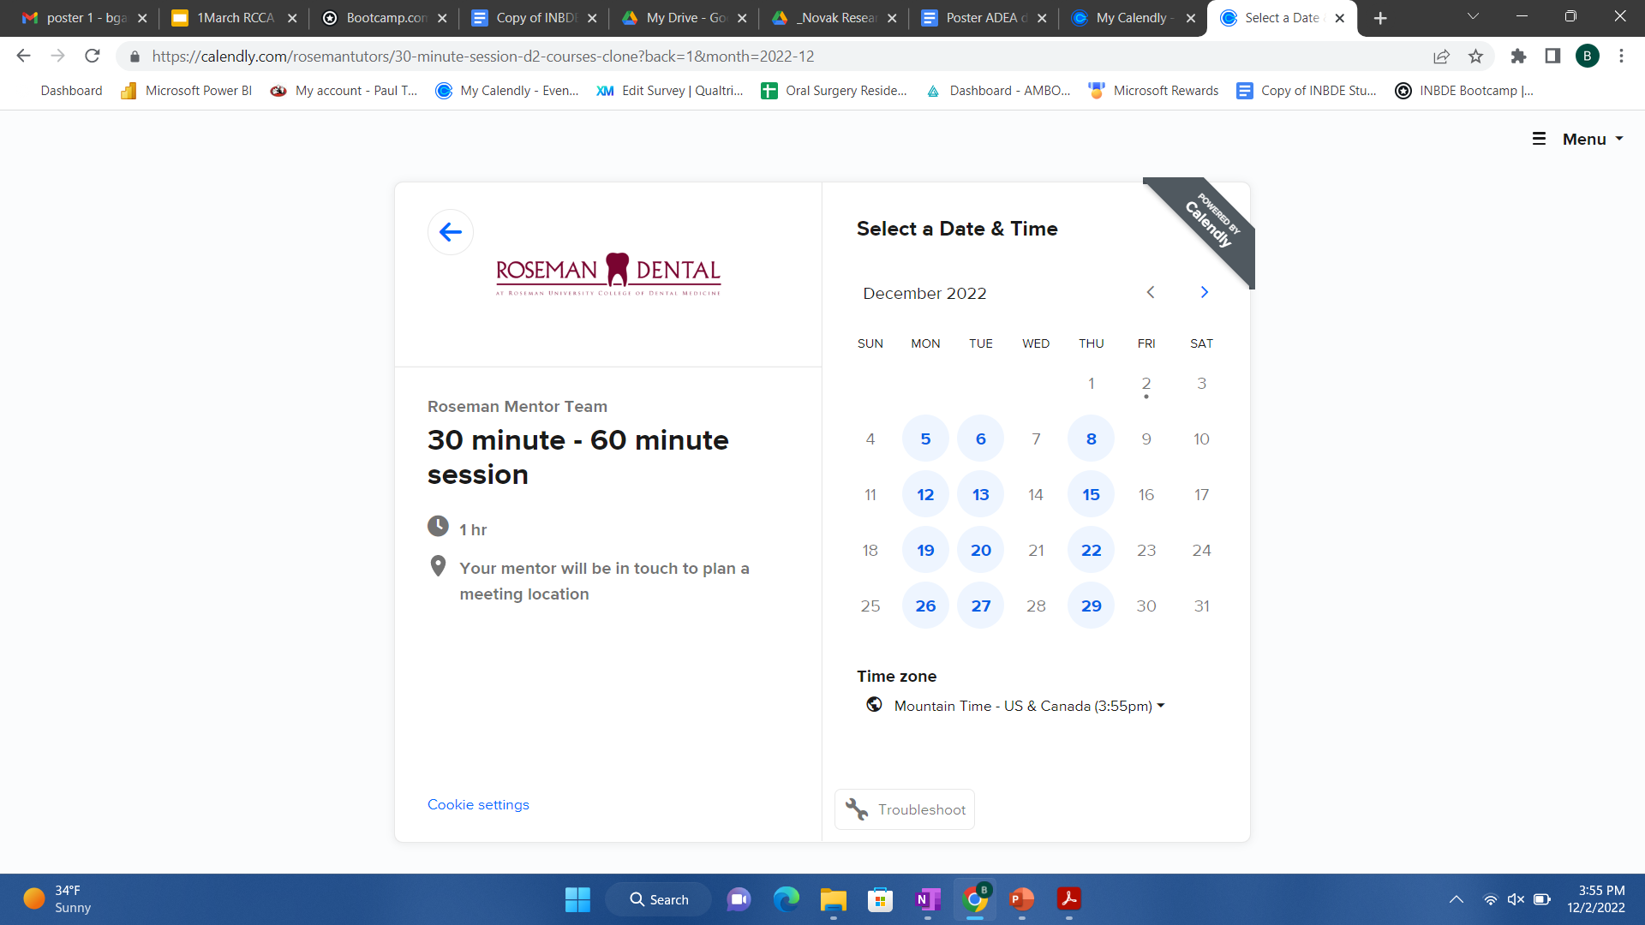
Increased Student Confidence and Decreased Anxiety through Peer Mentoring Programs
Bryce Gardner, Jacob Schvaneveldt, Edward Yeates, Rachel Novak
Roseman University of Health Sciences, College of Dental Medicine
Introduction
Results
Results
The Roseman Curriculum and Cultural Ambassador (RCCA) group was created to allow students to discuss topics of importance with peers and faculty, and to help bring about change and develop a culture of growth as lifelong colleagues.
Students involved in the ambassador group attend a monthly in-person meeting to discuss topics related to the university’s curriculum and culture. A topic of interest was the usefulness of a peer mentor/tutoring program in higher education and bringing such a program to Roseman.
There has not been much research done on peer tutoring at the graduate level, however from data that has been collected in one specific study, “Student evaluations generally indicated that students perceived that their academic performance improved in the course for which they were tutored (83% agreed or strongly agreed)” (White Gaughf, N, 2016).
Figure 1
Figure 2
Results collected from 36 Roseman dental students in a survey sent schoolwide. 61% of students reported feeling some level of stress pre-examination. 54% of students reported that tutoring would help them to feel less stressed for an exam, while 66% reported that they would feel more prepared for exams with tutoring.
Conclusion
Figures 1 and 2: data collected from the general survey about their perception of peer mentoring and the effectiveness in increasing confidence in higher education material and reducing test anxiety.
Most graduate students feel some level of stress pre-examination. Based on student perception, there is potential to increase student confidence and decrease student anxiety with the implementation of a peer tutoring program. More research to be conducted to assess the effectiveness of tutoring at a graduate level.
Future Research
Additional research must be done to observe the true effectiveness of tutoring at a graduate level, including surveying students who are utilizing the tutoring program pre- and post-examination.
Objective
To determine whether peer tutoring increases student confidence in graduate level material and reduces test anxiety.
Acknowledgements
Figure 3: The scheduling program used for tutoring session sign up. Scheduling is done through Calendly.com.
We appreciate the efforts of our tutors, Amir Faraji, Claire Reilly, Golnoush Zakeri, Sumaya Al Kalla and Sameem Norooz.
Methods
All dental students (D1-D4) at Roseman University were asked to participate in a general survey about their perception of peer mentoring. They were asked questions regarding its effectiveness in increasing confidence in higher education material and reducing test anxiety. Students being tutored in the peer mentor program were asked to participate in a pre and post exam survey with questions including confidence in material, test anxiety, and perception of mentor program before and after exams. (IRB-2022-017)
References
Santee, J., & Garavalia, L. (2006). Peer Tutoring Programs in Health Professions Schools. American Journal of Pharmaceutical Education, 70(3), 1–10. https://doi-org.roseman.idm.oclc.org/10.5688/aj700370
White Gaughf, N., & Smith Foster, P. (2016). Implementing a Centralized Institutional Peer Tutoring Program. Education for Health: Change in Learning & Practice, 29(2), 148–151. https://doi-org.roseman.idm.oclc.org/10.4103/1357-6283.188773
Figure 4: QR code with link to schedule for tutoring session.

