Slide 1
All You Need Is Time Leveraging Technology and Training to Reorganize Library Staff

Slide 2
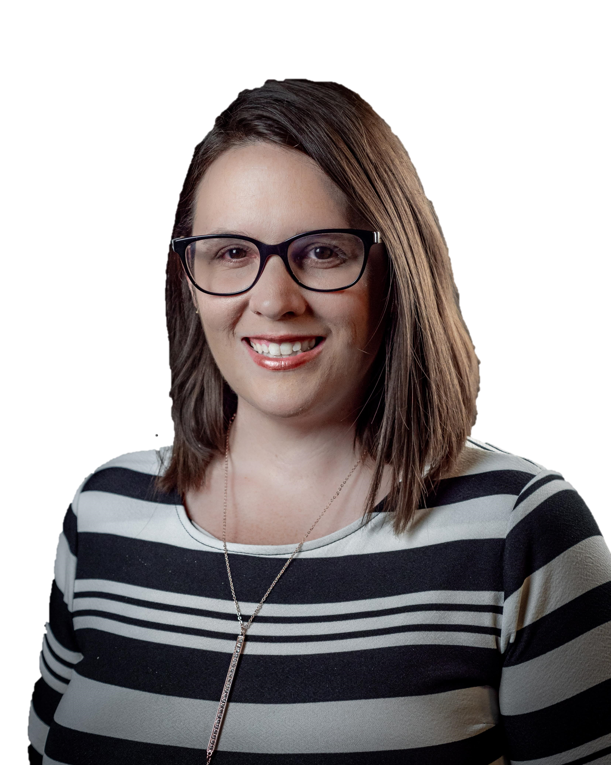
Hello!
I am Tiffany Garrett
Director of Library Services at Roseman University of Health Sciences
Notes:
Started in February
New Director and New to Health Sciences
Previously AD @ Nevada State College
Staff Reorg & Extended Access

Slide 3
Notes:
Founded in 1999 as a pharmacy school
3 campuses: South Jordan, UT / Henderson, NV / Summerlin, Las Vegas
By the Ethel M Chocolate Factory
Just under 1,000 students
Health Sciences programs: Pharmacy, Nursing, Dental Medicine
Founders still very much involved in the institution – University President, Instructor in COP

Slide 4
Agenda
Revolution
The Long and Winding Road
Here Comes the Sun
Why it was time for a change
The Implementation Process
Results from the first two months
1
2
3

Slide 5
1. Revolution
Why it was time for a change

Slide 6
Upcoming Changes
College of Medicine in 2-3 years
Desire to grow to 5,000 students with many new programs
Requests for 24/7 access to the library space

Slide 7
18% Drop
40% Drop
71% Increase
In Gatecounts
In Print Circulation
In Electronic Resource Use

Slide 9
Library Org Chart
Director
Assistant Director
Access & Systems Librarian
Admin Assistant
Research & Learning Librarian
Library Associate
Senior Library Assistant
Library Assistant
Part-Time Library Assistant
Research & Learning Librarian
Electronic Resources Librarian
Library Technician
Library Associate
Library Assistant
Senior Library Assistant
Part-Time Library Assistant
Service Desk Staff
VACANT
Notes:
6 positions (5 FTE) dedicated entirely to the service desk +12 hrs per week per campus of student worker assistance
2 positions (1.5 FTE) currently vacant
Need for a R&L Librarian at SJ
Difficult to cover the desk with generous leave time

Slide 10
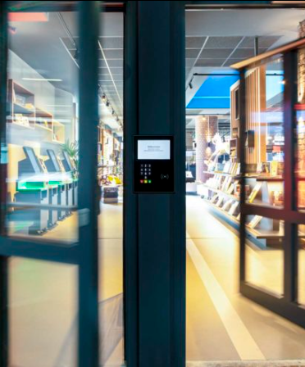
Extended Access Model
The library could be open with key card access and self-checkout options outside of staffed hours
Notes:
Allow us to shift some of those service desk positions to other growing areas
Better position us to serve the University through growth

Slide 11
Hours Change
Previous Hours
M-Th 7am – 9pm
Fri 7am – 5pm
Sat Noon – 5pm
New Staffed Hours
M-Th 8am – 7pm
Fri 8am – 5pm
Open Hours
M-F 6am – 11pm
Sat-Sun 10am – 6pm

Slide 12
SWOT Analysis
STRENGTHS
Staff that are motivated to contribute more
WEAKNESSES
Difficulty covering the desk
Lack of training for service desk staff
S
W
Key card access-based campus
RFID and other technology
Budget for training
OPPORTUNITIES
Perception of the library
Being seen as just a space
THREATS
O
T

Slide 13
2. The Long and Winding Road
The Implementation Process

Slide 14
Roadmap
Admin Approval
Keycard access & security
RFID implementation
1
3
5
2
4
6
RFID vendor
Reorganization of Library Staff
RFID trainng and troubleshooting
Notes:
Admin Approval
Future salary savings
Growth areas and the needer for different roles
Engaged and capable staff
RFID Vendor
Access & Systems Librarian
Someone who could get the equipment delivered by June 30th
Did not get referrals from other libraries or receive training before equipment was delivered
Did not have a full understanding of how it would work with our existing systems (Koha, authentication)
Keycard access & security cameras
Supply chain issues meant we had to be flexible about which products
Really benefited from admin support in terms of becoming a priority
Reorganization
Started July 1 with goal of everyone fully working in their new roles by October
Some training and professional development will be ongoing
RFID Implementation
RFID chipped and programmed ~4,000 books per campus
Made decisions about odd items like remotes and models
Made the call to move our reserves collection to a book cart only accessible during staffed hours
RFID training and troubleshooting
Has been ongoing, regret the quick timeline to our decision
All student facing and security functionality works, but we aren’t able to get the data we were promised
Did not know things like that it would create a two step process for check-in/out and would need a dedicated computer

Slide 15
Library Org Chart - Previous
Director
Assistant Director
Access & Systems Librarian
Admin Assistant
Research & Learning Librarian
Library Associate
Senior Library Assistant
Library Assistant
Part-Time Library Assistant
Research & Learning Librarian
Electronic Resources Librarian
Library Technician
Library Associate
Library Assistant
Senior Library Assistant
Part-Time Library Assistant
Service Desk Staff
VACANT
Notes:
6 positions (5 FTE) dedicated entirely to the service desk +12 hrs per week per campus of student worker assistance
2 positions (1.5 FTE) currently vacant

Slide 16
Library Org Chart - New
Director
Assistant Director
Access & Systems Librarian
Research & Learning Librarian
Research & Learning Librarian
Instructional Design Assistant
Service Desk Manager
Research & Learning Librarian
Admin Assistant
Head of eResources & CD
Service Desk Manager
Cataloging & Archives Assistant
Acquisitions & ILL Assistant
eResources Assistant
Service Desk Staff
Promotion
Notes:
Lost 2 positions (1.5 FTE) – but they were both vacant so there were no layoffs
9 positions received a promotion and a raise

Slide 17
Where We’re At
Done
Live with extended access
Staff working in new roles
Self-checkout and RFID security system
Ongoing
Staff training and support
Troubleshooting issues with the gate counting functionality

Slide 18
Lessons Learned
More time to assess and prepare the technical side
Phased staff reorganization to avoid gaps in training

Slide 19
3. Here Comes the Sun
Results from the first two months

Slide 20
THANK-YOU for helping to support our students this way I know space to study is deeply appeciated by students and I’ve heard them request more access to the library for literal years now. This is a big win for our students.
Notes:
Professor in the College of Pharmacy
Several other grateful comments from faculty and students
Unanimous support from Deans and Administrators

Slide 21
Notes:
Staff seem happy.
University willing to invest in them.
Excited and engaged in their new roles.

Slide 22
Library Org Chart - Turnover
Director
Assistant Director
Access & Systems Librarian
Research & Learning Librarian
Research & Learning Librarian
Instructional Design Assistant
Service Desk Manager
Research & Learning Librarian
Admin Assistant
Head of eResources & CD
Service Desk Manager
Cataloging & Archives Assistant
Acquisitions & ILL Assistant
eResources Assistant
Service Desk Staff
Promotion
Notes:
2 librarians have left
Communicated to me that it’s not because of the reorganization
One position that was promoted and one that was not
Hybrid/remote work – higher pay – different opportunities that this institution wasn’t prepared to offer

Slide 23
14% Increase
10% Increase
In South Jordan Gatecounts
In Henderson Gatecounts
Notes:
We notice this even during hours when we were always staffed – coming in at 8am there are way more students in the library than ever before at that hour

Slide 24
Questions?

Slide 25
Thanks!
Contact Me
tgarrett@roseman.edu
/tiffanymgarrett

